Slide 1
Giving Effective Essay Feedback
Kylie Cummings

Slide 2
About me
2nd year
Kapolei, Hawaii
A bit of a writing nerd (English major)
Plays too much games

Slide 3
About my school
Kaho Junior and Senior High School
Iizuka city
1000+ students total
Science and culture courses
Both very high and very low English levels

Slide 4
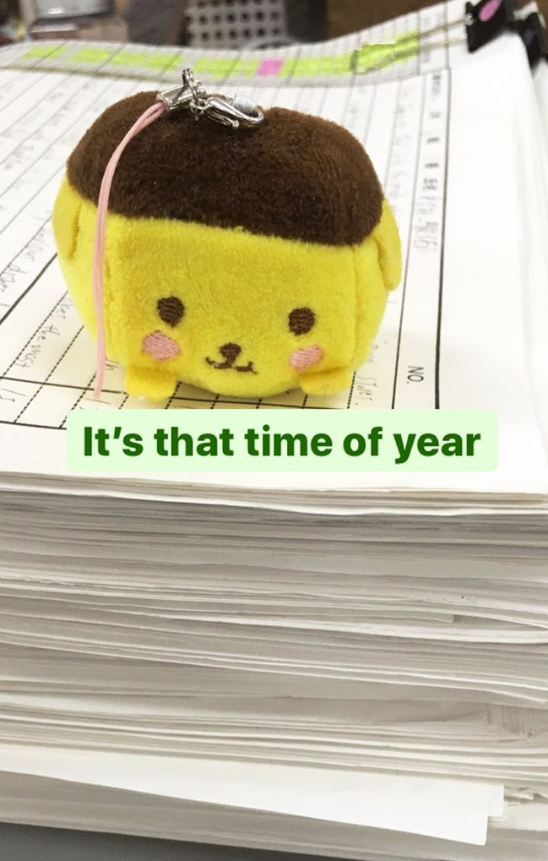
Why Talk about this?
We all have to do it
Variety of tools = more adaptable!
BUT
Context-dependent
No “best” method
Notes:
I’m sure everyone has experienced being handed a stack of essays to “correct” with no additional directions (or maybe just a generic “fix the grammar”)
The information in this presentation can apply not only to those kinds of essays but also things like eiken practice, speech drafts, or entrance exam preparation.
This presentation is not going to advocate one specific method over others. This area of writing/feedback is too context-dependent for that. Rather, I will explain the different forms of feedback, their pros and cons, and the types of errors they are most effective on.
My hope is that by providing a variety of feedback methods, you will be able to find the one(s) that are best for your particular situation or even change your style depending on the class/assignment/etc. (ESID and all that)

Slide 5
Sample Correction
1 Minute
Correct the sample however you like
Discussion
What did you focus on? Why?
How does your style differ from the people around you?
2 Minutes
Notes:
See handout

Slide 6
Survey
Who focused on…
Correcting style: Did you…
Grammar?
Content?
Fix all mistakes?
Fix only some of the mistakes?
Highlight without correcting?
Do something completely different?

Slide 7
Notes:
So this is the original text which I corrected in November of last year. This was from a 3rd year student (SHS) in one of my lower level classes.
As you can see, I corrected almost every mistake. The only mistake that I marked without correcting was in the first sentence, where the student called Hawaii a “city.” I had hoped that drawing attention to it would be enough for the student to realize their mistake.
Almost everything else, from spelling mistakes to grammar errors, were fixed. (except the “OMG 😱” – that was too charming to cross out)
When my JTE brought this essay to me, she specified that (1) she wanted me to focus on grammar and (2) the students would not be rewriting these.
With that in mind, I thought it would be best to both mark the errors and fix them since the students (between the lower level and lack of follow up assignments) might not feel motivated to figure it out on their own.
Note: this was probably not the best method I could’ve used

Slide 8
Research Limitations
No consensus
Mostly focused on specific errors (e.g., articles)
Mostly done at university level
Notes:
There are certain limitations to the research I’ve done.
As I mentioned before, this area is very dependent on context.** I’ll explain that context more later. But it does mean that there is not much consensus on what is a “good” method, or even what makes a method “good” in the first place. How do we measure improvement in essay writing? Are we looking for certain grammar points? Better structure or support? Less mistakes in general? Etc.
The research that does focus on error improvement only covered certain types. I’ll get into error types later as well, but the issues these researchers measured might not be the same ones that your students need help with.
Lastly, it’s important to note that most of the research was done with university students in countries other than Japan. This means a couple things. First, the findings might be less applicable for young students (especially ES or JHS). The students’ English levels and motivations might affect the research in ways that aren’t helpful for us. This also means some Japan-specific issues we face might not be accounted for; it’s up to us to apply this information in a way that matches our environments.

Slide 9
To correct or…not?
Early vs recent research

Slide 10
Early research
Pre 1997 research: Grammar correction is ineffective and even damaging
Based primarily in composition studies
Focus on the writer/process, not the end result
Flawed research
ESL vs EFL settings
Incomplete data
Recent research
Conclusion:
Any feedback > no feedback
New focus:
Contextual things
Notes:
Early research was based more in composition studies than second language acquisition.
In composition studies, the teacher is less concerned with the technical points of a student’s essay (grammar especially) and more focused on improving the writer themselves.
This results in a focus on content and structure; teachers do not give a lot of direct answers and grammar is not a focus until near the end of the writing process.
(This is fine for native English speakers. I’d argue that in general, focusing on the writer is much more important than fixing the writing. But not in a second language setting)
Based on this mindset, pre-1997 researchers argued that grammar correction is at best ineffective and at worst damaging.
Their research was flawed. For one, researchers did not differentiate between ESL and EFL settings, and some of the data they cited was actually statistically insignificant.
These strong statements sparked a bit of a debate in this field, and while modern researchers haven’t come to a complete consensus, there are a few things that they agree on.
Any feedback is better than no feedback. Most EFL/ESL students lack the language foundation to benefit from composition studies-based methods. Feedback helps build/strengthen that foundation.
Context is important in determining what is effective. We’ll get into this in a little bit.

Slide 11
Error types
Global/Local
Treatable/Untreatable
Global:
Impedes comprehensibility
Local:
Does not impede comprehensibility
Same error can be global or local
Treatable:
Rule-based, easily addressed/fixed
Ex. Verb tense, subject-verb agreement
Untreatable:
Idiosyncratic, nuanced, requires explaining
Ex. Word choice, sentence structure
Notes:
Before we look at feedback types, I think it’s important that we quickly go over error types (these also affect feedback effectiveness)
I’m going to talk about 2 different dichotomies.
Global/Local
Global errors are the ones that make the sentence/essay unreadable. I’m sure you’ve seen these before. Those sentences where you just stare at the paper in bewilderment, unsure of where to start or what your student is even trying to say. Maybe you show it to your JTE for help, only for them to also have no idea either. Those are global errors (albeit the worst possible ones).
Local errors are the opposite. You can tell it’s an error, but you still understand what the student is trying to say. It might just be a spelling error, or they used the wrong verb tense.
It is important to note that the same mistake can be global or local depending on the situation.
Treatable/Untreatable
Treatable errors are rules-based and easy to address or fix. Examples include different verb forms/tenses, subject-verb agreement, or capitalization rules.
Untreatable errors are the ”idiosyncratic features” of writing. Because they are more nuanced, it requires more explaining on our end (as the native speakers). Examples include sentence structure, word choice, or idioms.

Slide 12
Types of Feedback
Comprehensive/Selective
Direct
Coded
Indirect
Uncoded
Reformulation
Notes:
There are two main feedback types that I’ll be explaining here: Direct and Indirect. Indirect can be further divided into coded and uncoded feedback.
I’m also going to explain reformulation a little because it’s relevant but it’s not exactly a good method
All these methods can either be comprehensive or selective.

Slide 13
Direct Feedback
Teacher both identifies and corrects errors
Pros
Cons
Generally preferred by both teachers and students
Easy
Low-level students
Potentially less engagement
Overwhelming
Notes:
First, direct feedback.
In this case, the teacher both identifies and corrects errors.
Almost all the corrections I did in the sample correction were direct.
It’s a simple, clear method, and both teachers and students seem to prefer it. In general, it seems that low-level students benefit most from this form. Similar to what I mentioned earlier in the “Early research” section, low-level students lack a foundation in English, so direct feedback shows them both where they went wrong and the correct form.
However, because we are essentially giving students all the answers this way, students may potentially be less engaged in their writing. Also, if you mark all errors, the sea of red marks may be overwhelming or discouraging for students.

Slide 14
Indirect feedback
Teacher identifies errors but doesn’t correct them
Uncoded: indicates presence of errors but does not label
Coded: points to exact location and labels errors
Notes:
In indirect feedback, the teacher identifies the error in some way but does not correct them
In coded feedback, these errors are labeled, often with proofreading marks like these.
Uncoded feedback, on the other hand, indicates that errors are present but does not tell the student what kind of errors they are.
This could be done by circling the errors (as seen in my sample “Hawaii is an excellent and exciting city to visit”) or by tallying the number of errors in a line or sentence.

Slide 15
Indirect feedback
Teacher identifies errors but doesn’t correct them
Pros
Cons
Forces engagement
Teaches editing skills
Might help with retention
Frustrating/intimidating
Could decrease motivation
Must lay groundwork beforehand
Notes:
In general, indirect feedback forces the student to engage with their writing more, might help them develop their own editing skills, or show them where their weak points are. Because they are relatively more engaged, it might help with short term retention. In terms of long-term retention, there is no evidence that indirect is more effective than direct feedback. They seem to be about equally effective.
There are some difficulties with indirect feedback though. For one, it can be much more frustrating and intimidating at first, especially with lower level students.
This can lead to decreased motivation.
Also, laying the groundwork beforehand is essential. For someone like me, who corrects a lot of essays from classes I’ve never seen, this is a huge barrier.

Slide 16
Reformulation (Teacher rewriting)
Supposedly effective
Lacking research
Prevents students from developing own ideas/voice
May undermine motivation/confidence
Notes:
Reformulation, also known as teacher rewriting, is…not good. Not for our purposes, at least.
Just as the name implies, this is when teachers rewrite the student’s work with the correct grammar or vocabulary.
You might be familiar with or used this method for spoken feedback. This would be when you rephrase what the student just said in the correct way without specifically drawing attention to the error.
Example (spoken) – Student: “I am going to the park last Friday” Teacher: “Oh, you went to the park last Friday? What did you do?” etc.
Some researchers claim this method is useful for written feedback, but they are lacking research to support that claim.
It does prevent students from developing their own ideas and voice, and it may undermine their motivation and confidence, though.
So until more research is done on its effectiveness, I would advise against using it when you can.
However, I know that this is often exactly what we are asked to do (or at least, I am). You might not have a say all the time, but it’s probably best to avoid it when you can.

Slide 17
Selective or Comprehensive?
Selective is almost always more effective
Less overwhelming
Issues:
1. Students not realizing that there are other errors
2. Takes more time
3. Assignment type matters
4. JTE matters
Notes:
Each feedback type I’ve gone over so far can be used in one of two ways – selectively or comprehensively.
Selective feedback focuses on only a few specific errors, while comprehensive feedback covers any and everything in the student’s work.
Example of selective feedback: only marking verb tense errors on a review worksheet while ignoring things like capitalization or spelling errors.
Selective feedback is almost always more effective than comprehensive, and it can be less overwhelming (see also: that sea of red marks I mentioned earlier)
However, there are some issues with selective feedback that might make it harder to use
The students might not realize that there are errors other than the ones you marked. This can be overcome by laying the groundwork early on and specifying what kind of errors you are fixing.
It takes more time. Comprehensive feedback is kind of easy in that you just mark any error you come across. Selective feedback requires teachers to be more engaged in their corrections, which might get tiring if you have a stack of 300 to get through.
Assignment type matters. Things like eiken practice essays might benefit more from comprehensive feedback than a review worksheet
JTE matters. Each JTE has their own preference. It’s probably best to check with them to avoid misunderstandings and clashing

Slide 18
Selective Feedback: New Questions, No answers
How many features/error types do we focus on?
Which ones? How do we decide?
Notes:
So we know that selective feedback, in general, is better.
But there are some questions that are (again) context dependent and have no clear answer
How many features or error types do we focus on?
Both focusing on too few and too many features can be detrimental for students, so how do we find balance?
I don’t have an answer. I’m still trying to figure out what is best for each of my classes.
Which features do you we focus on? How do we decide?
This one is probably a bit easier if you are teaching/reviewing grammar. The errors you should focus on are the ones you taught. I’m sure you already knew that.
But what about, say, an essay from summer break or a speech draft? It’s a little less clear in these cases.
You know your classes best, so the best way to answer these questions is probably to work with your JTEs to make sure your goals are aligned

Slide 19
Things to Consider (“Context”)
Error Type
Treatable + indirect
Untreatable + direct
If selective, global and repeat errors should be prioritized
Your students’ level
Lower level students & indirect feedback
Notes:
I mentioned ”context” a lot in this presentation. These are the things I think you should consider when choosing a feedback method.
Error type
In general, these are the combinations that seem to be the intuitive and effective
Treatable errors can easily be marked using indirect feedback. Because these are rules-based errors, it doesn’t require much explanation on your part and can help reinforce what the students learned in class
Untreatable errors should be marked using direct feedback. These are more nuanced errors, so students might not even be able to fix these without additional explanation from you or the JTE
If you’re being selective with your feedback, the focus should be on errors that impede comprehension (aiming for understandable, not perfect) and repeat errors (trying to break bad habits)
Student level
As I mentioned earlier, lower level students benefit more from direct feedback than indirect because they don’t have a strong enough foundation to reference. Indirect feedback can be especially discouraging to them. On the other hand, higher level students might enjoy the challenge of a more selective indirect method
A personal example: I teach a Japanese culture class that has a focus on reading and writing. It’s a small class (around 20), and these kids have the lowest English levels in the school by far. We do a lot of worksheets and they’re allowed to do rewrites/resubmit assignments (they rarely do). What I’ve learned from teaching this class is that they just…don’t respond to indirect feedback. Many of them will completely ignore the marks or literally come to me for the correct answers because they can’t figure it out on their own. As a result, my usual approach is giving direct feedback and (when possible) going over things with each student individually

Slide 20
Things to Consider (“Context”)
Assignment type/focus
Are there going to be rewrites? Is it a one-time thing?
Content or grammar?
Is there a specific grammar point you’re looking for/testing?
JTE Preferences
Probably supersedes all other points (sorry.)
Notes:
Assignment type or focus
I mentioned this a bit in the Selective/Comprehensive section, but I’ll go into more detail here
Again, the way you approach a review worksheet should probably be different from something like university entrance exam practice.
Students might feel less motivated to decipher indirect feedback on a one-off assignment (vs. one with multiple rewrites)
If focusing on content, global errors should take priority and reformulation should be avoided as much as possible
If focusing on specific grammar, selective feedback is probably best
JTE preferences
Honestly, there’s not much you can do here (unless they actually value your opinion?)¥
Mine prefer direct + comprehensive feedback but yours might be different

Slide 21
Five Conditions for Effective Feedback
Lindsay Mack
“Issues and Dilemmas: What Conditions
are Necessary for Effective Teacher
Written Feedback for ESL Learners?”
Feedback must be
Formative
Timely
Draw Attention to Error
Avoid Appropriation
Have a Criterion
Low stakes, ongoing
Less than 1 week
Direct or indirect ok
Selective, avoid rewriting
Use a rubric
Notes:
Just something I found in one article that I thought was nice and concise.
Feedback should be low stakes and an ongoing process
Assignments should be returned in a timely manner, preferably in under a week
Attention should be drawn to errors; direct and indirect forms both apply here
Appropriation (rewriting/reformulation) should be avoided
If you do have to grade student writing, make a clear rubric (and show it to them)

Slide 22
What type of feedback do you think is best for your school(s)? Why? How does what you think is best differ from what your JTEs ask for (if at all)?
Discussion
3 Minutes

Slide 23
In Conclusion
“Effective” is subjective
Different tools for different situations
Lay groundwork in advance
Avoid reformulation when possible
Match the feedback to the error type and student level

Slide 24
references
Bitchener, John, et al. “The Effect of Different Types of Corrective Feedback on ESL Student Writing.” Journal of Second Language Writing, vol. 14, no. 3, 2005, pp 191-205, doi:10.1016/j.jslw.2005.08.001.
Bitchener, John. “Written Corrective Feedback for L2 Development: Current Knowledge and Future Research.” edited by Dana Ferris, TESOL Quarterly, vol. 46, no. 4, 2012, pp. 855-860, doi: 10.1002/tesq.62.
Duppenthaler, Peter. “The Effect of Three Types of Written Feedback on Student Motivation.” JALT Journal, vol. 24, no. 2, 2002, pp. 130-154, doi.org/10.37546/JALTJJ24.2-2.
Elwood, James, and Jeroen Bode. “Student Preferences vis-à-vis Teacher Feedback in University EFL Writing Classes in Japan.” System, vol. 42, 2014, pp. 333-343, dx.doi.org/10.1016/j.system.2013.12.023.
Eslami, Elham. “The Effects of Direct and Indirect Corrective Feedback Techniques on EFL Students’ Writing.” Procedia - Social and Behavioral Sciences, vol 98, 2014, pp. 445-452, doi:10.1016/j.sbspro.2014.03.438.
Ferris, Dana. “The Case for Grammar Correction in L2 Writing Classes: A Response to Truscott (1996).” Journal for Second Language Writing, vol 8, no 1, 1996, pp. 1-11, doi.org/10.1016/S1060-3743(99)80110-6
Ferris, Dana. “Second Language Writing Research and Written Corrective Feedback in SLA: Intersections and Practical Applications.” Studies in Second Language Acquisition, vol. 32, no. 2, 2010, pp. 181-201, doi:10.1017/S0272263109990490.
Hartshorn, K. James, et al. “Effects of Dynamic Corrective Feedback on ESL Writing Accuracy.” TESOL Quarterly, vol. 44, no. 1, 2010, pp 84-109, doi.org/10.5054/tq.2010.213781.
Mack, Lindsay. “Issues and Dilemmas: What Conditions are Necessary for Effective Teacher Written Feedback for ESL Learners?” Polyglossia, vol. 16, 2009, pp. 33-39.
McCord, Molly. “Exploring Effective Feedback Techniques in the ESL Classroom.” Language Arts Journal of Michigan, vol. 27, no. 2, 2012, pp. 41-45, doi.org/10.9707/2168-149X.1905.
McMartin-Miller, Cristine. “How Much Feedback is Enough?: Instructor Practices and Student Attitudes Toward Error Treatment in Second Language Writing.” Assessing Writing, vol. 19, 2014, pp. 24-35, dx.doi.org/10.1016/j.asw.2013.11.003.

